Slide 1
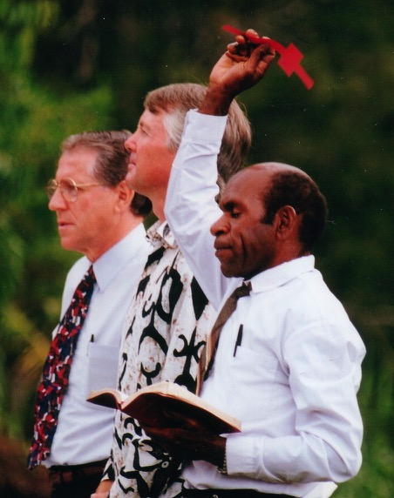

Specialty Sermons
Evangelistic
Wedding
Funeral
Dr. Rick Griffith • Jordan Evangelical Theological Seminary • BibleStudyDownloads.org

Slide 2

Why the 15-Minute Limit?
It saves time in class
If you are a pastor, you will preach many short specialty sermons in the future

Slide 3
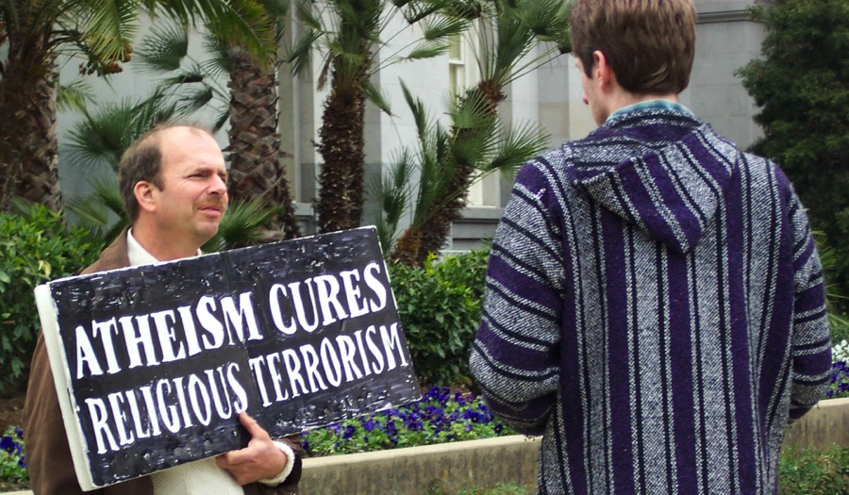
Evangelistic Speaking
199
Notes:
Atheism only substitutes non-religious terrorism for it. This has been shown to be even more deadly by Hitler, Mussolini, Stalin, Mao, Pol Pot, and others.

Slide 4
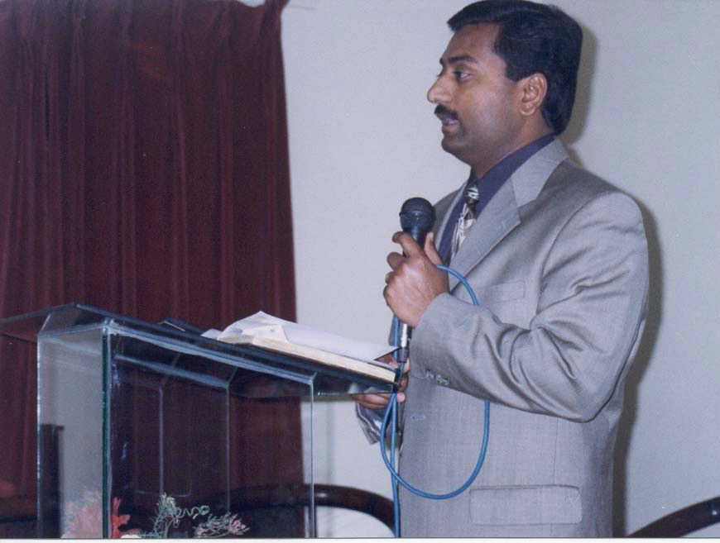
Uniqueness of the Situation
199
Their interest
Satan's attack
Mixed crowd

Slide 5
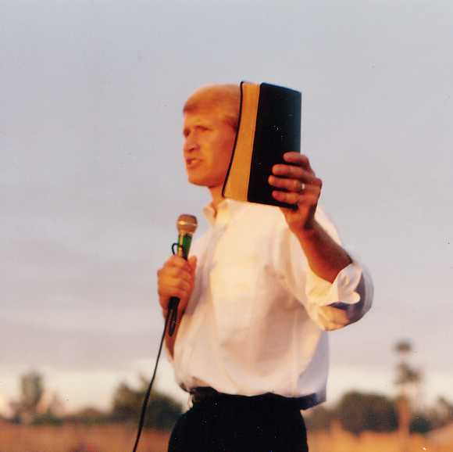
Tips in
Evangelistic Preaching
199

Slide 6
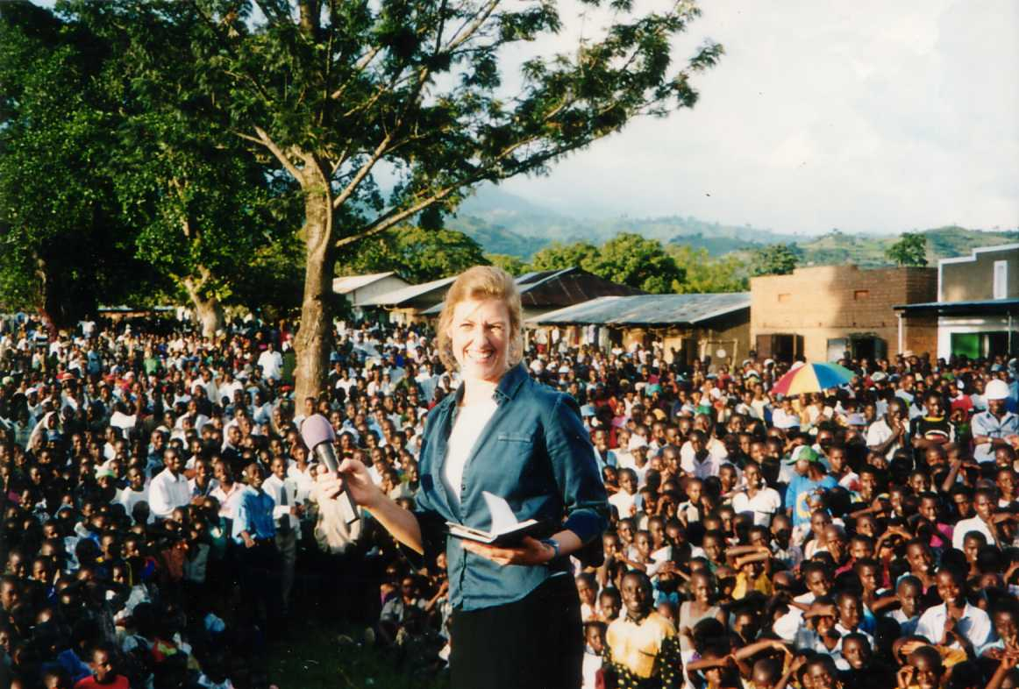
Preach to the Non-Christians

Slide 7

Preach Expository Messages
199
Give the story of the gospel from the Bible itself

Slide 8

Preach Hell and the Solution
199
Second Coming
Church Age
Eternal Kingdom
Evangelism
Judgment

Slide 9
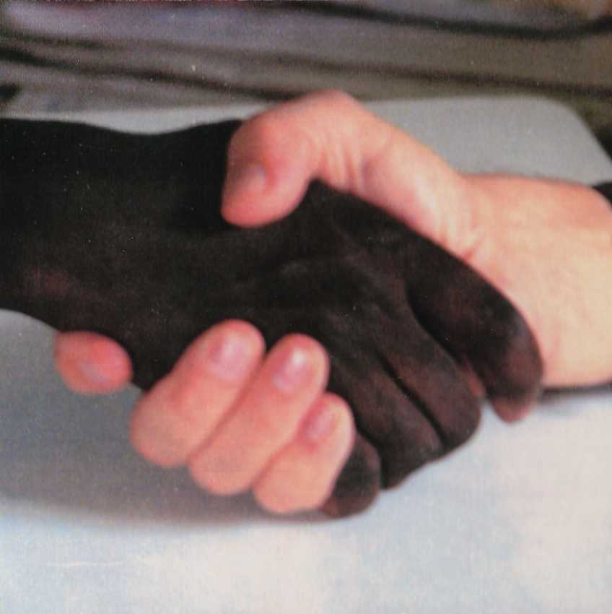
Preach the Gospel
199
Christ died for our sins
He was buried
He was raised
He appeared
(1 Cor. 15:1-8)

Slide 10
USE A SUBSTITUTION ILLUSTRATION
200-202
Book
Cancer
Kai
Snake
Drawbridge

Slide 11

Most–The Movie
A father must make the painful decision whether to kill his own son in order to save the lives of people on an oncoming train
Notes:
A father must make the painful decision to kill his own son in order to save the lives of people on an oncoming train
http://www.wingclips.com/movie-clips/most/the-bridge

Slide 12
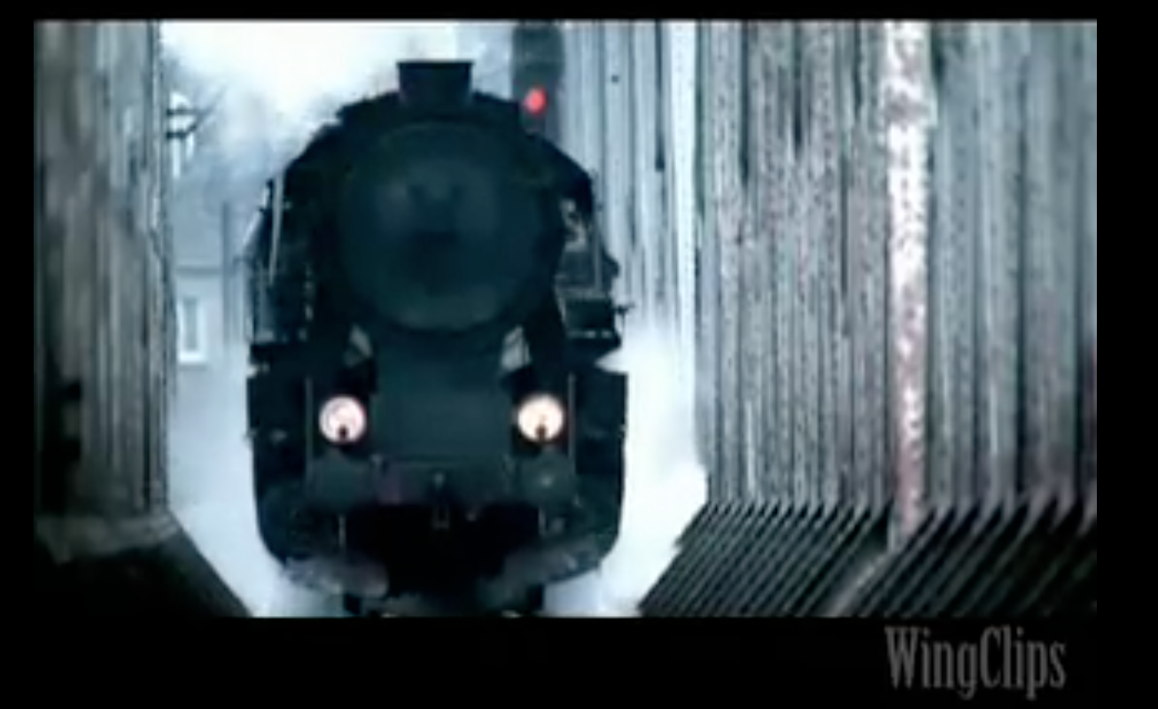

Most–The Movie
A father must make the painful decision to kill his own son in order to save the lives of people on an oncoming train
Notes:
A father must make the painful decision to kill his own son in order to save the lives of people on an oncoming train
http://www.wingclips.com/movie-clips/most/the-bridge

Slide 13
USE A SUBSTITUTION ILLUSTRATION
200-202
Book
Cancer
Kai
Snake
Drawbridge
Twins
Soldier

Slide 14

12 Other Principles from…
199
Pray
Positive
Focus
Press
Exalt Jesus
Personal
Simple
Plead
Proclaim
Brief
Urgent
Depend

Slide 15
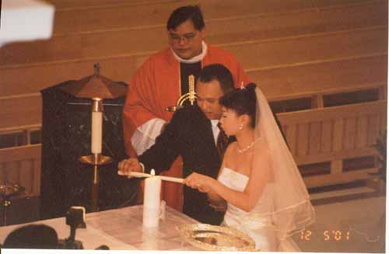
How to Preach at Weddings
204

Slide 16
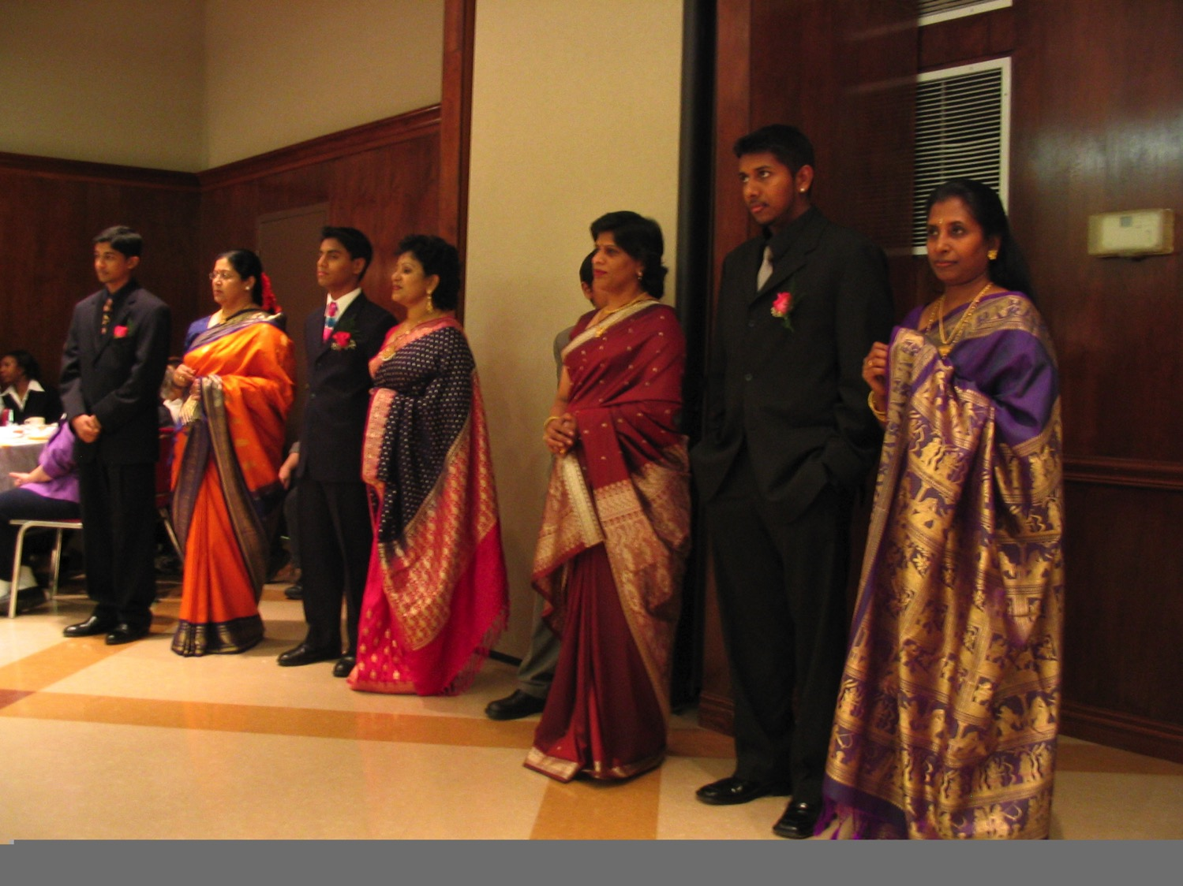
What's Unique about Wedding Messages?
204

Slide 17
They aren't there to hear you!
204

Slide 18
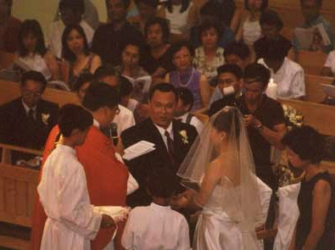
Other Unique Things…
204
They aren't listening
Joy plus nervousness

Slide 19
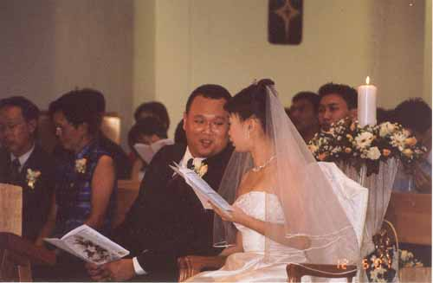
Other wedding tips…
204
Be brief
Target audience
People don't bring their Bibles
Be personal
Use humour
Always share the Gospel

Slide 20
Funeral Preaching
An Introduction

Slide 21
Uniqueness of the Funeral
205
People aren't there to listen to you
Share about the afterlife
People never die at convenient times
The audience is mixed
It's your chance to share in a home
Grief is real

Slide 22
Funeral Preaching Tips
205
Don't worry about raising interest
Include more illustrations
Read more Scripture
Have a pastoral tone
Be personal
Always share the gospel
Be short

Slide 23
Black

Slide 24


Preaching (Homiletics) link at BibleStudyDownloads.org
Get this presentation for free!
Notes:
Preaching (pr)
Homiletics

